Slide 1




Open Data Open Notebook Science
Peter Murray-Rust,
Open Science, Rio, BR, 2014-08-22

Slide 2
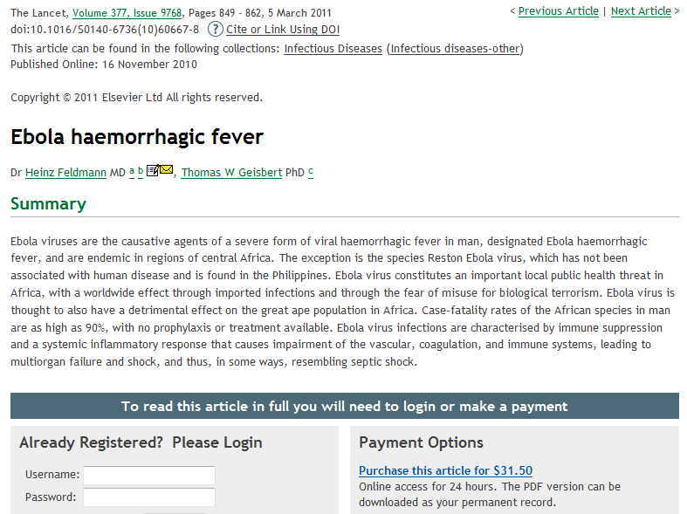
Retrieved 2014-08-08
Lancet 2011
31 USD
For 1 day
PMR: Closed Access Means People Die

Slide 3
Overview
Most scientific data is lost; costs many billions…
… AND LIVES.
Human problem; lack of vision + active opposition.
Born-open data and Open Notebook Science
Jean-Claude Bradley
Panton Principles and Fellows (OKFN)
Digital Enlightenment or Digital Darkness?

Slide 4
Reasons for Open Data/Science
Moral: Closed can be unjust
Ethical: Community norms expect it
Utilitarian: Greater communal good f
Personal: Greater personal benefit

Slide 5
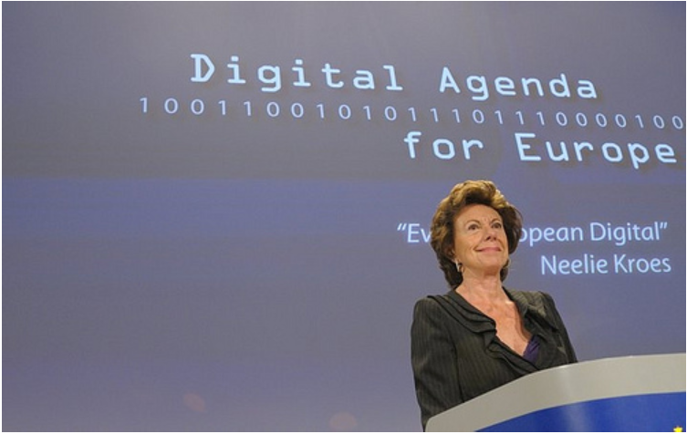
RCUK
Wellcome
ERC
NSF
FWF…
require
fully OPEN
[at Research Data Alliance, we are entering a new “era of open science”, which will be “good for citizens, good for scientists and good for society”.
She explicitly highlighted the transformative potential of open access, open data, open software and open educational resources – mentioning the EU’s policy requiring open access to all publications and data resulting from EU funded research.
http://blog.okfn.org/2013/03/21/we-are-entering-an-era-of-open-science-says-eu-vp-neelie-kroes/#sthash.3SWDXDE6.dpuf

Slide 6
Scientific and Medical publication (STM)[+]
World Citizens pay $400,000,000,000…
… for research in 1,500,000 articles …
… cost $300,000 each to create …
… $7000 each to “publish” [*]…
… $10,000,000,000 from academic libraries …
… to “publishers” who forbid access to 99.9% of citizens of the world …
[+] Figures probably +- 50 %
[*] arXiV preprint server costs $7 USD per paper

Slide 7
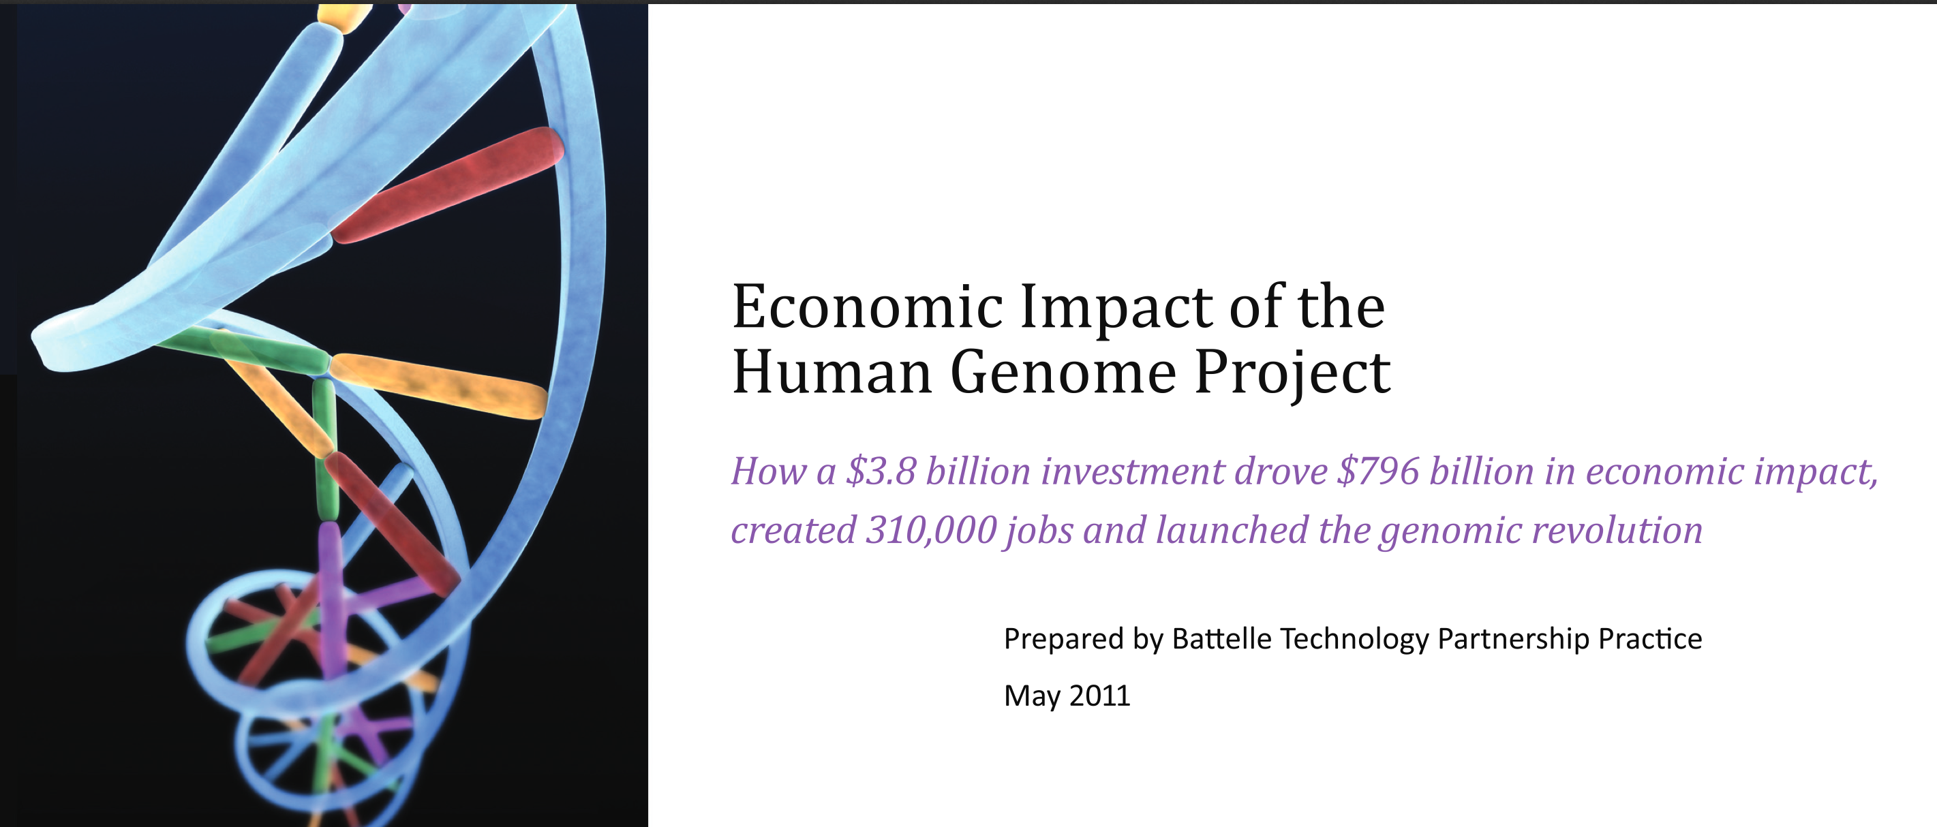
US Taxpayers spend 139 Billion USD / yr
on Scientific Research
4 Billion USD on human genome
yielded 800 Billion USD and 4 M job-years

Slide 8
Bad publication wastes science
…three problems—flawed design, non-publication, and poor reporting—together meant >85% of research funds were wasted, a global total loss >100 billion USD per year. [Lancet 2009http://www.thelancet.com/journals/lancet​/article/PIIS0140-6736%2809%2960329-9/fu​lltext.]
[Even more] waste clearly occurs after publication: from poor access, poor dissemination, and poor uptake of the findings of research.
[PLOS Medicine 2014-05-27 DOI: 10.1371/journal.pmed.1001651]

Slide 9
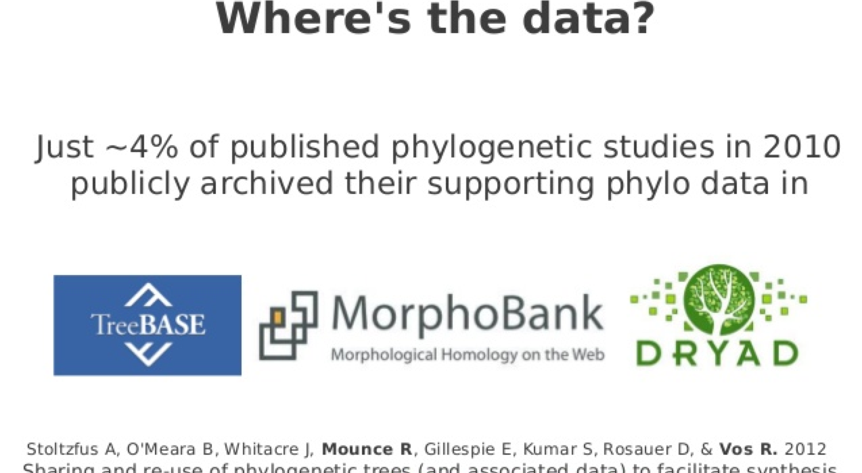
Authors don’t deposit data (Ross Mounce)

Slide 10
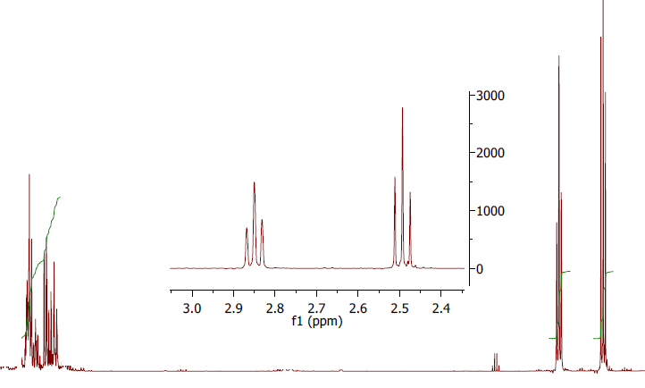
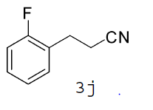
C) What’s the problem with this spectrum?
Original thanks to ChemBark
Org. Lett., 2011, 13 (15), pp 4084–4087
Notes:
ChemBark

Slide 11
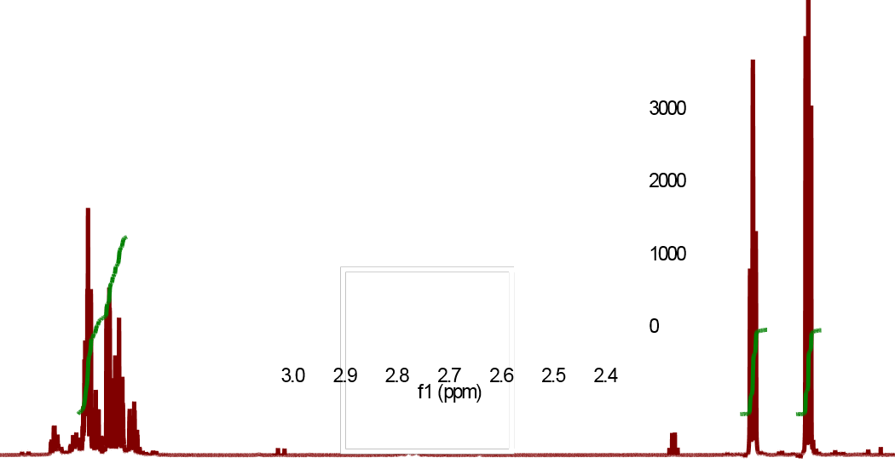
After AMI2 processing…..
… AMI2 has detected a square

Slide 12
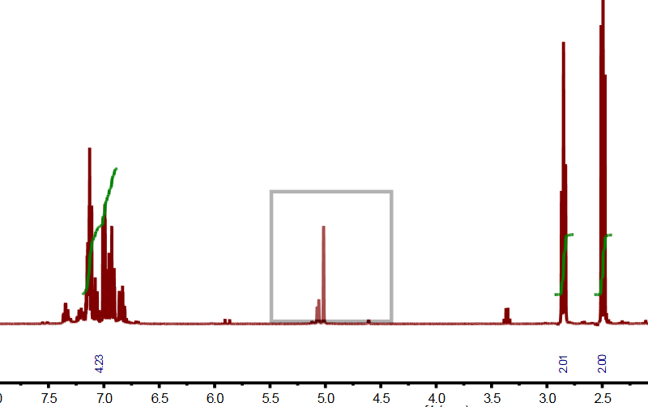

Slide 13
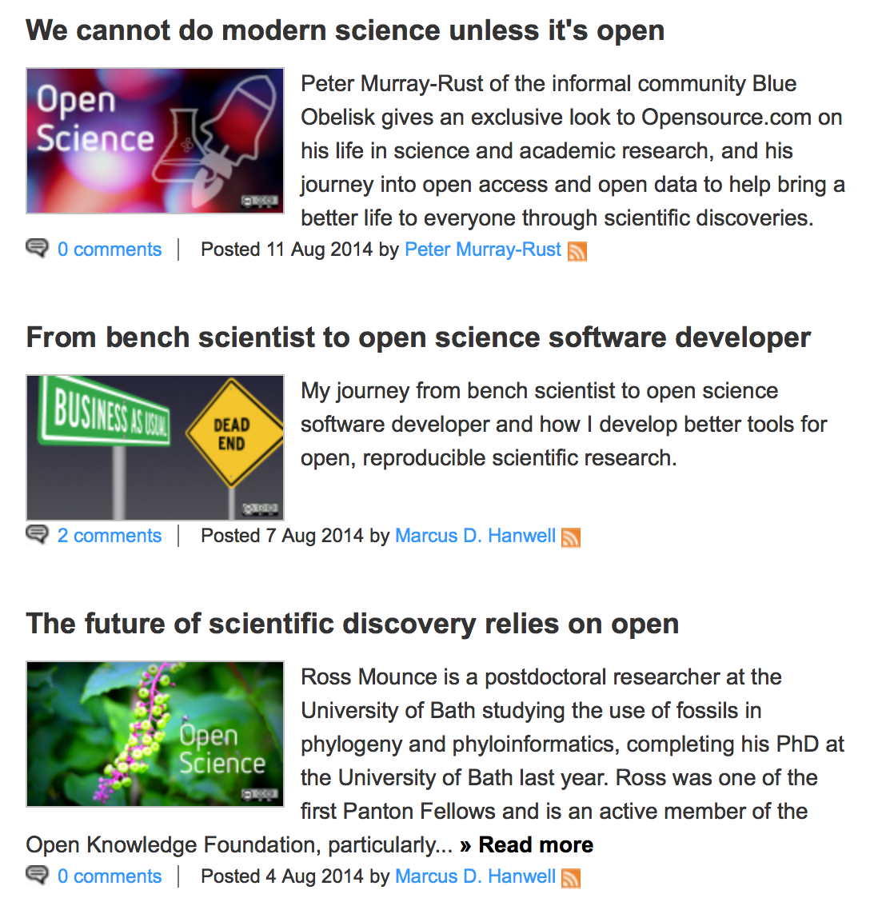
PM-R writes about how Open gave him 5 jobs
August 2014
Marcus Hanwell
http://opensource.com/tags/open-science
Ross Mounce

Slide 14
Traditional Research and Publication
DATA
process “belongs”
to publisher
???
rewrite
“Lab” work
Write
paper/thesis
publish
Validation??
Re-experiment
output “belongs”
to publisher
Walls of
academia

Slide 15
Free/Open Software Development
validate
CODE REPOSITORY
NO WALLS
CODE
rewrite
fork
CODE
Re-use
inspires
Re-use
CODE
CODE
OSI
World
community
Github, BitBucket
StackOverflow,
Apache
BORN-OPEN-SOURCE
Example: ContentMine at
http://github.com/ContentMine/quickscrape

Slide 16
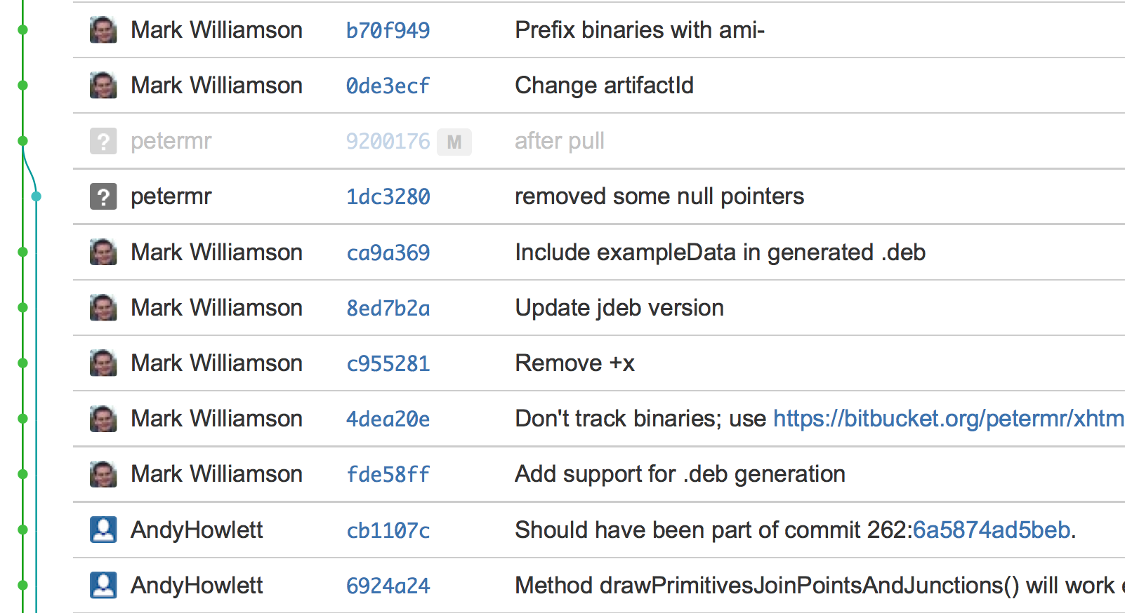
BornOS commits in 4 hours

Slide 17
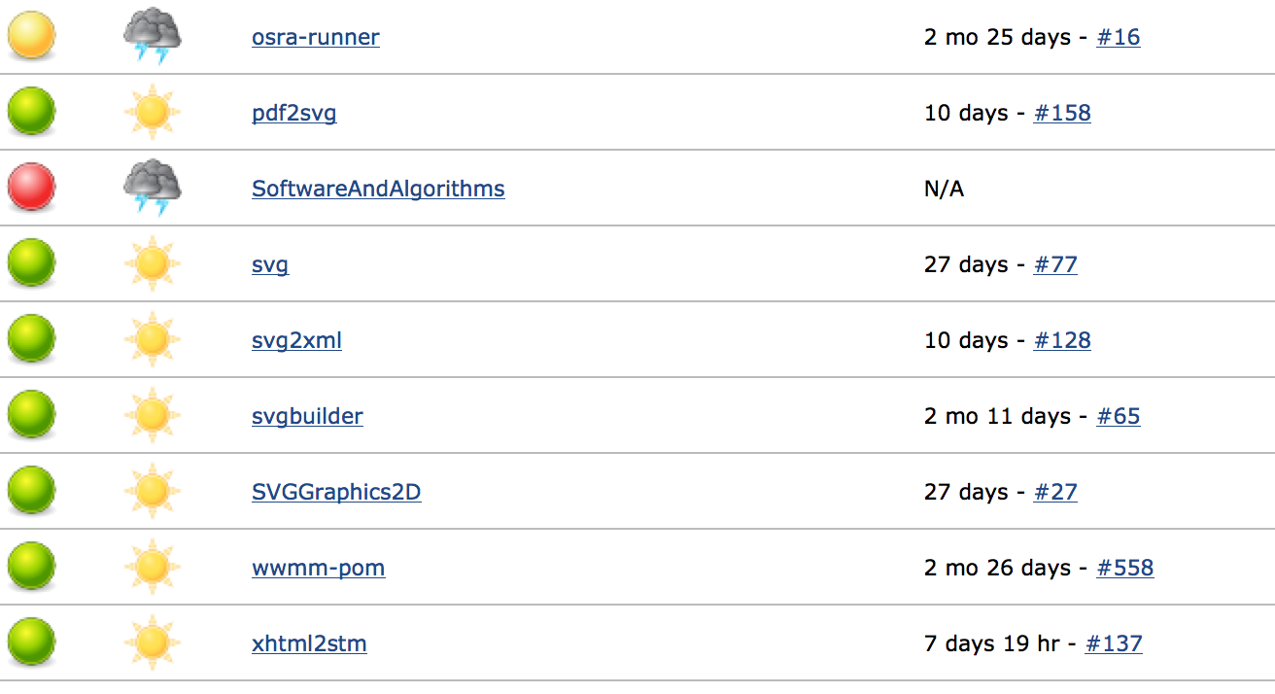
Continuous integration in PMR group does the code still work?

Slide 18
Open data

Slide 19
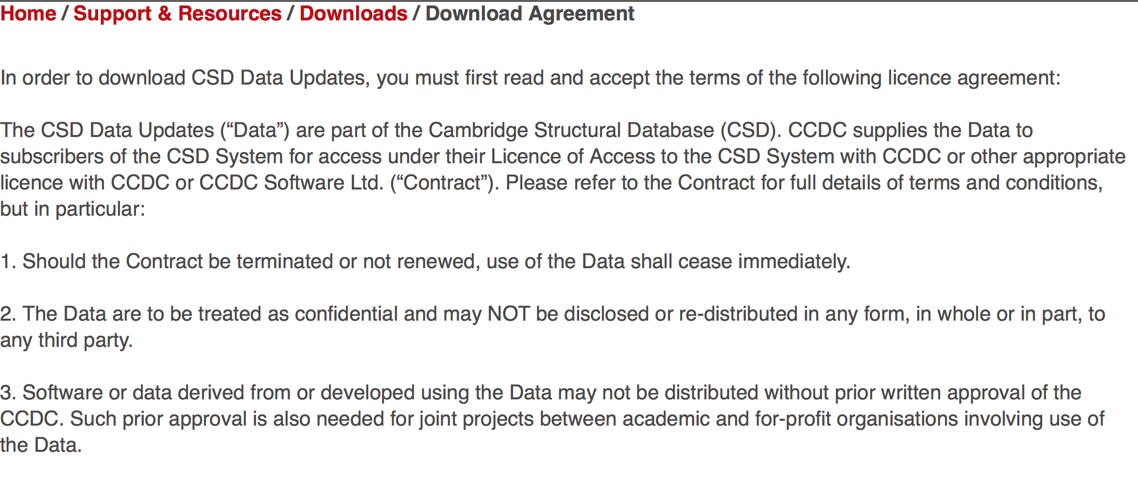
Restrictions on Re-use of Crystallographic data
NOTE: The CCDC is based on data contributed by
scientists as part of publication and validation

Slide 20
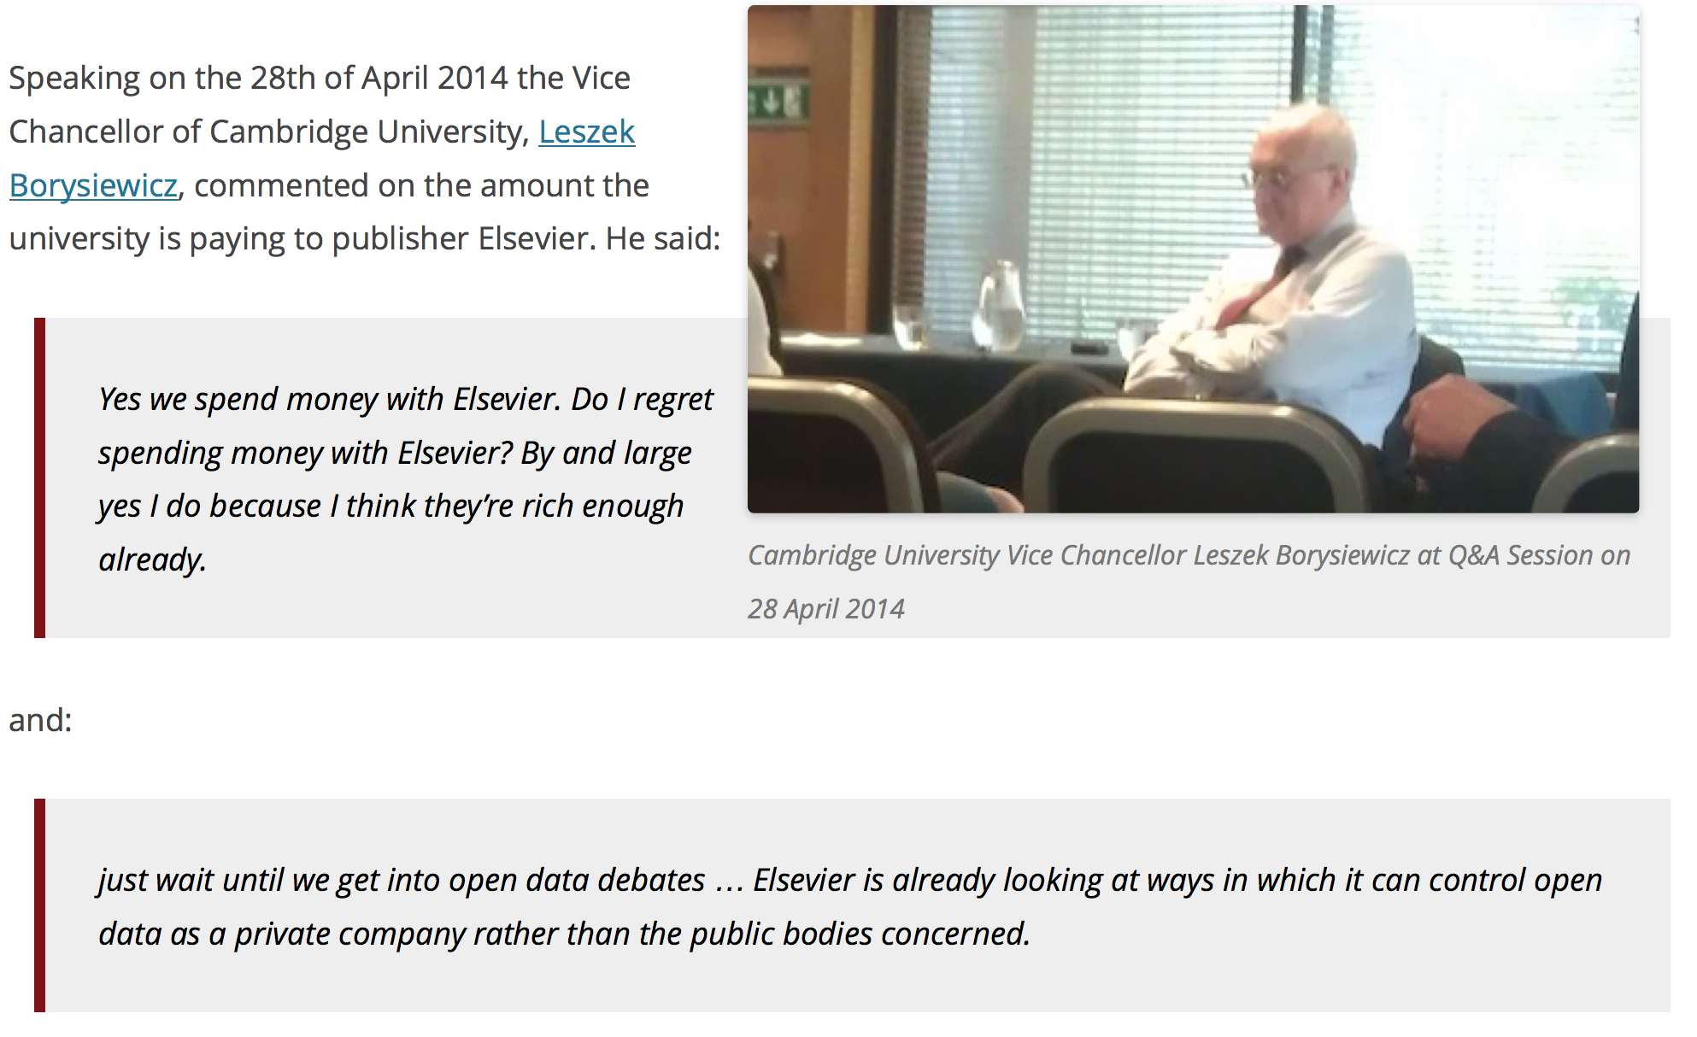
Elsevier wants to control Open Data
ViceChancellor Cambridge
[asked by Michelle Brook]

Slide 21
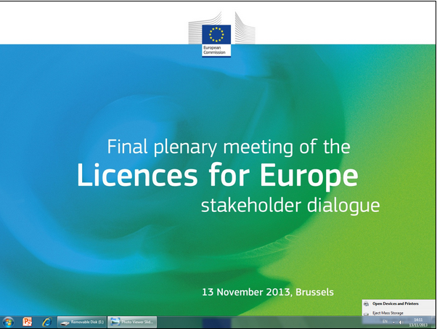
Licences destroy Content Mining
WE WALKED OUT
Brit Library
JISC
RLUK
OKFN
…
Ross Mounce
PM-R
STM Publishers Licence
2012_03_15_Sample_Licence_Text_Data_Mining.pdf
(Summary: PMR has NO rights)
[cannot publish to: ] “libraries, repositories, or archives”
[cannot] “Make the results of any TDM Output available on an externally facing server or website”
“Subscriber shall pay a […] fee”
Heather Piwowar: “negotiating with publishers [made me physically ill]”

Slide 22
Human Genome Project
https://en.wikipedia.org/wiki/Bermuda_Principles
Automatic release of sequence assemblies larger than 1 kb (preferably within 24 hours).
Immediate publication of finished annotated sequences.
Aim to make the entire sequence freely available in the public domain for both research and development in order to maximise benefits to society.

Slide 23
Panton Principles for Open Data in science(2010)
PUBLISH YOUR DATA OPENLY
…make an explicit and robust statement of your wishes.
Use a recognized waiver or license that is appropriate for data.
open as defined by the Open Knowledge/Data Definition (… NOT non-commercial)
Explicit dedication of data … into the public domain via PDDL or CCZero
Peter Murray-Rust, Cameron Neylon, Rufus Pollock, John Wilbanks

Slide 24
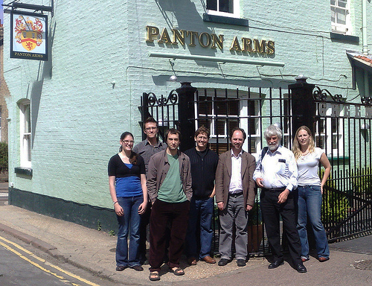
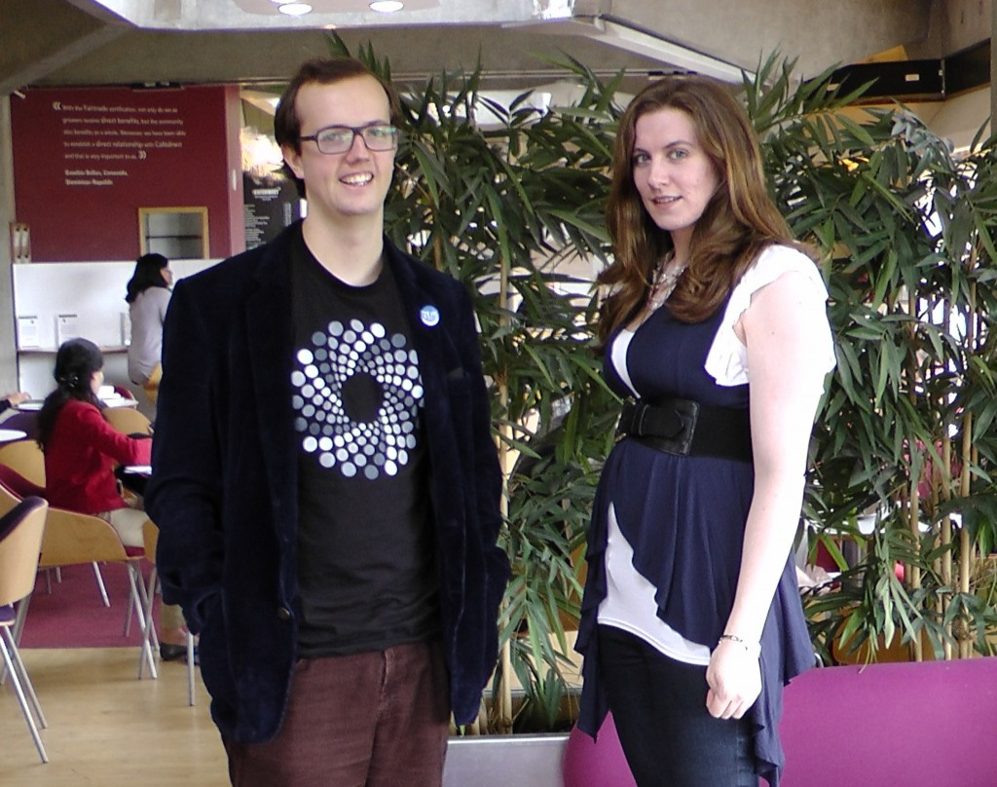
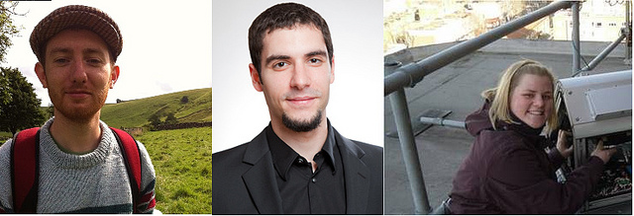
Panton Authors and Fellows

Slide 25
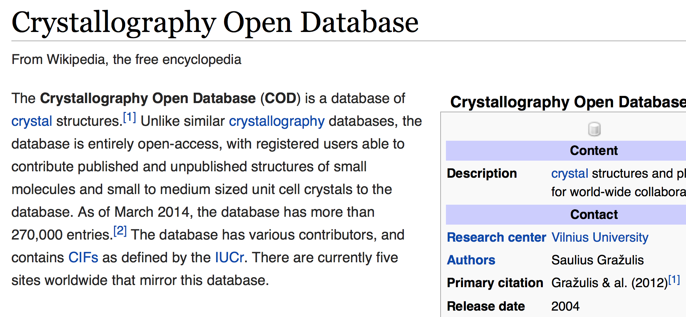
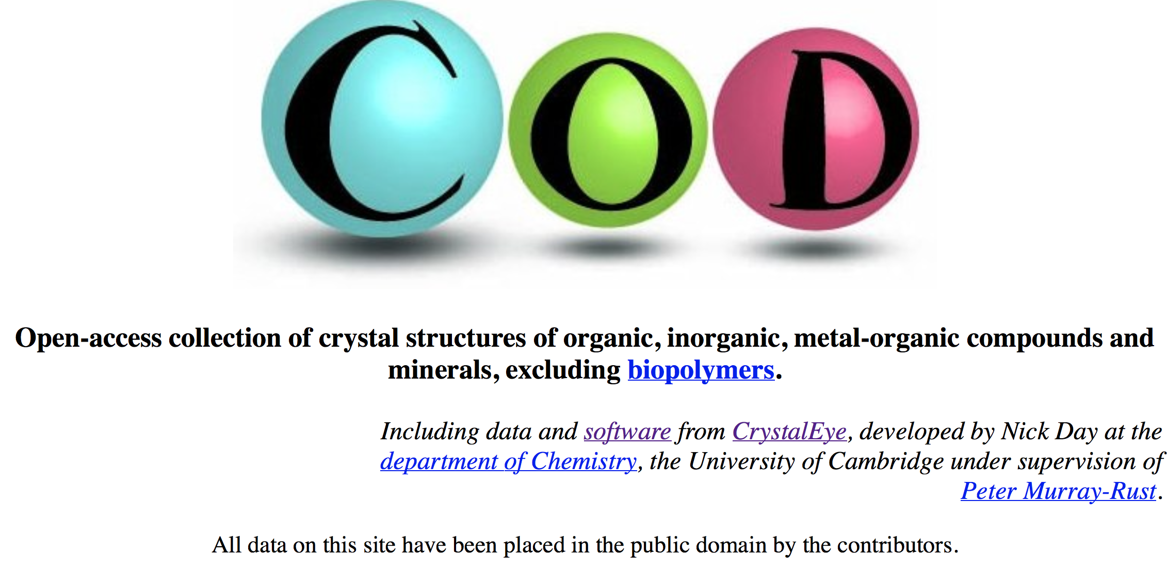

Slide 26
Open Notebook Science

Slide 27
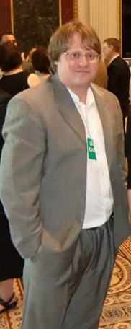
Open notebook science is the practice of making the entire primary record of a research project publicly available online as it is recorded. (WP)
Jean-Claude Bradley was a chemist who actively promoted Open Science in chemistry,… He coined the term Open Notebook Science. … A memorial symposium was held July 14, 2014 at Cambridge University, UK.^{[9]}

Slide 28
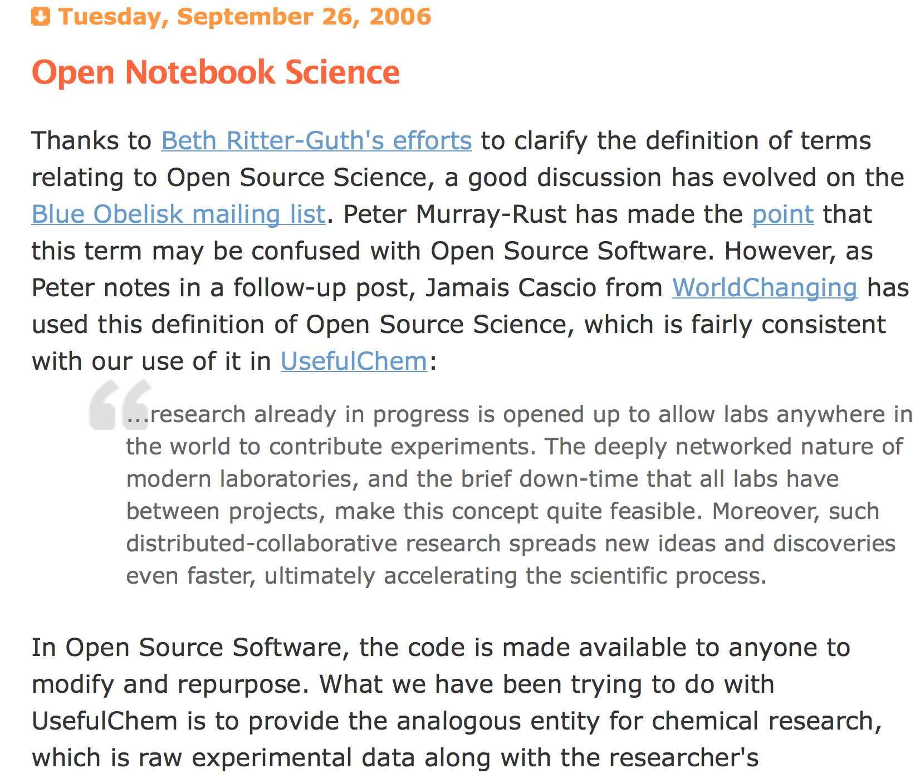

Slide 29
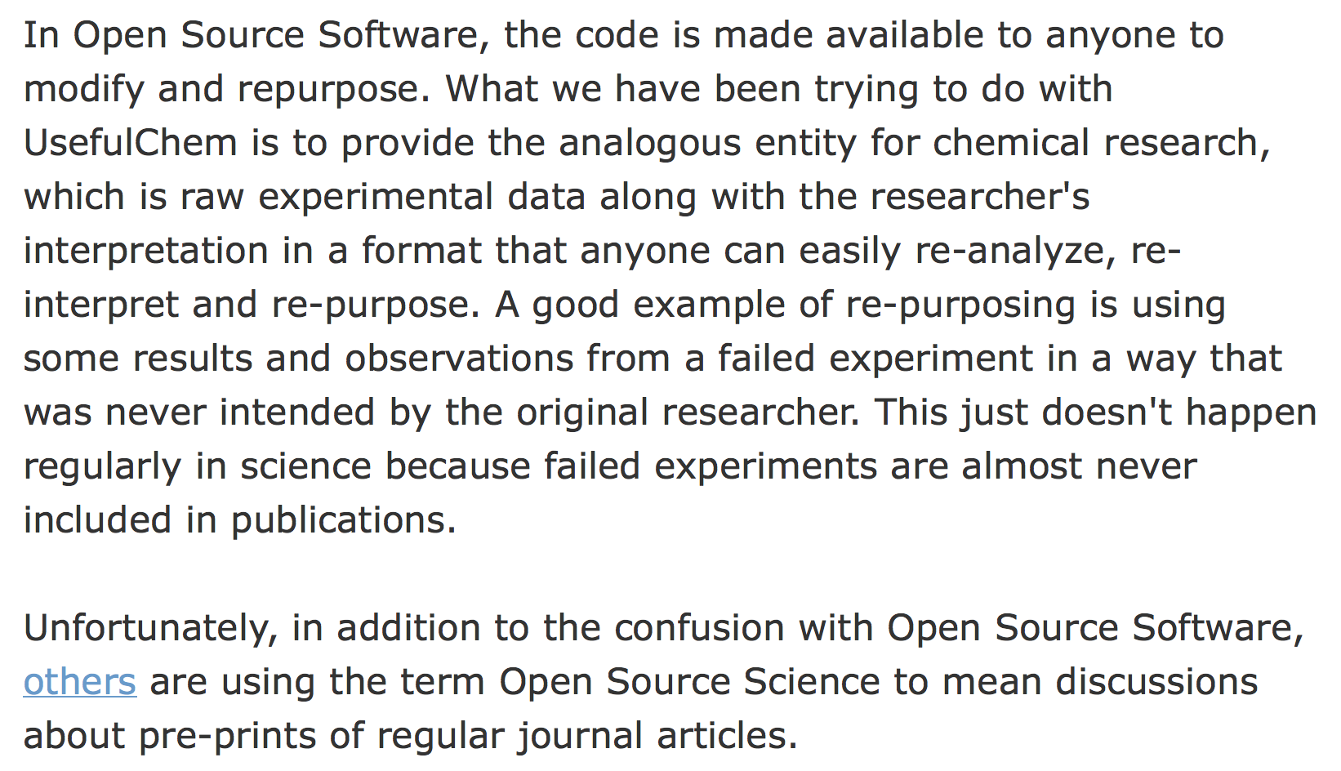
Open Source software inspires Open Science
Jean-Claude Bradley 2006

Slide 30
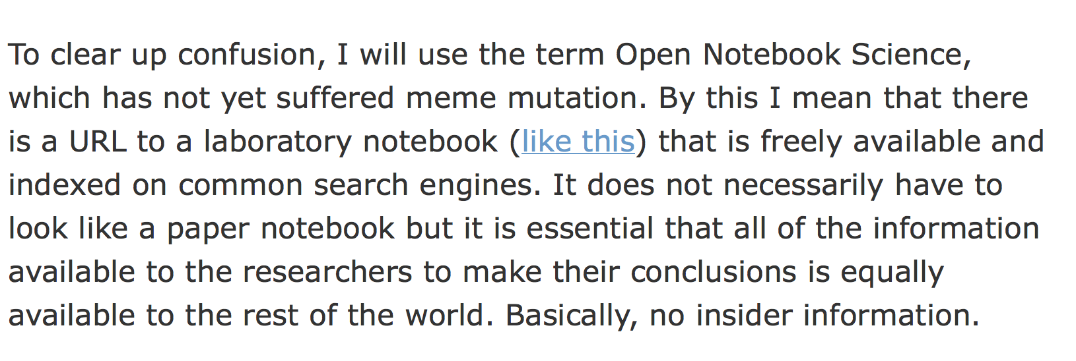
Open Notebook Science, ONS
Jean-Claude Bradley 2006

Slide 31
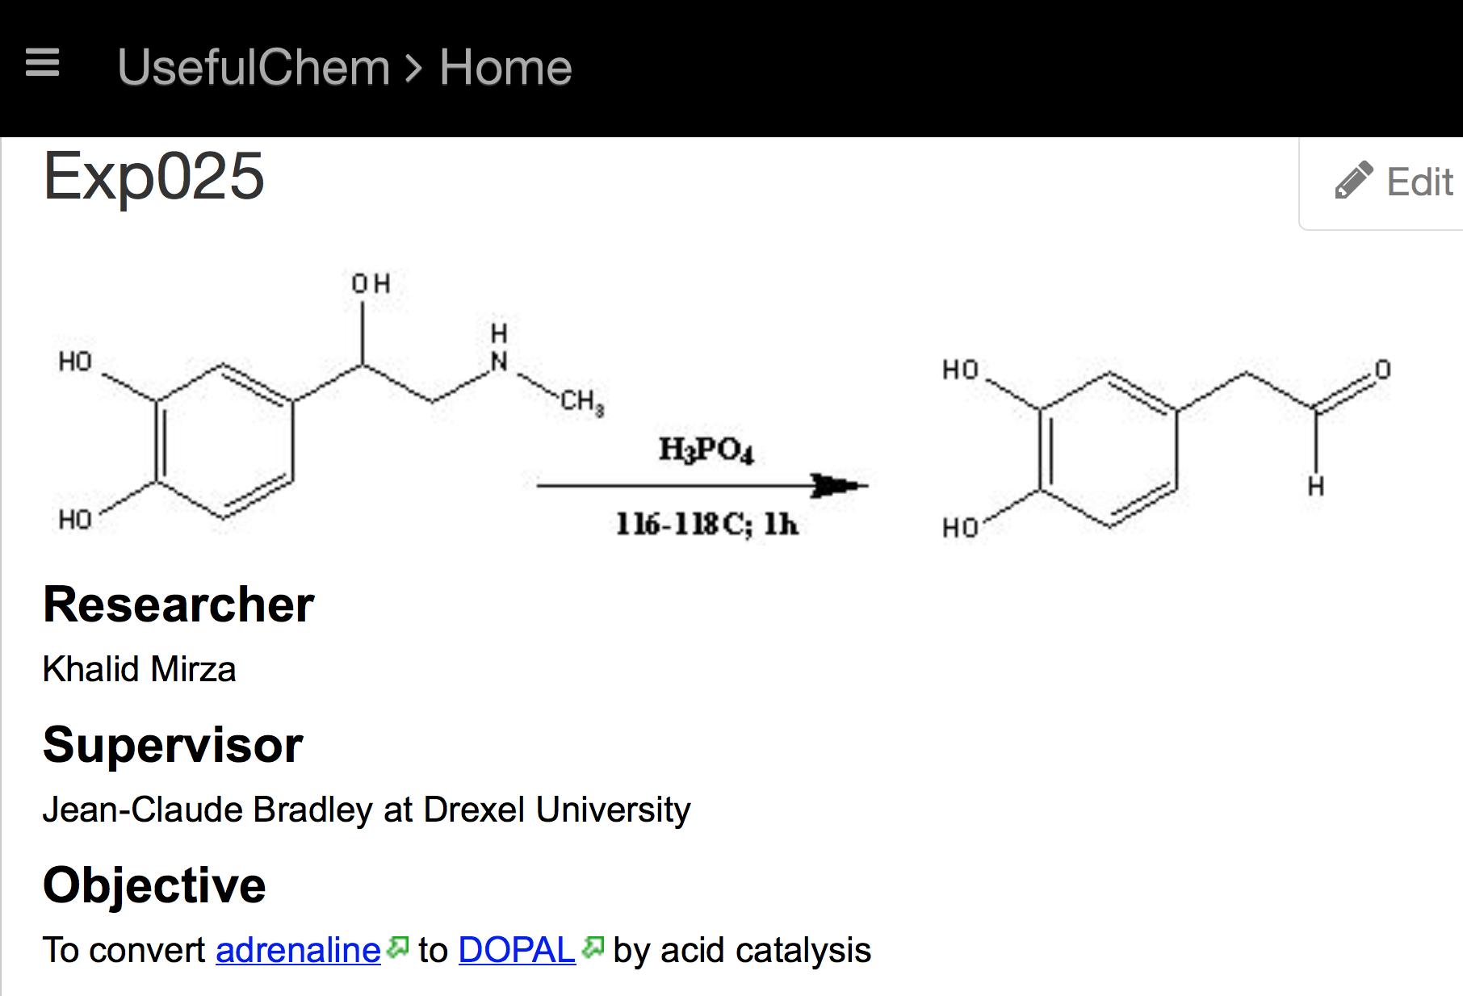
Jean-Claude Bradley 2006

Slide 32
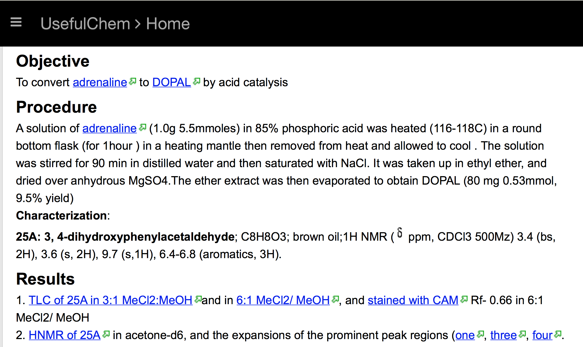
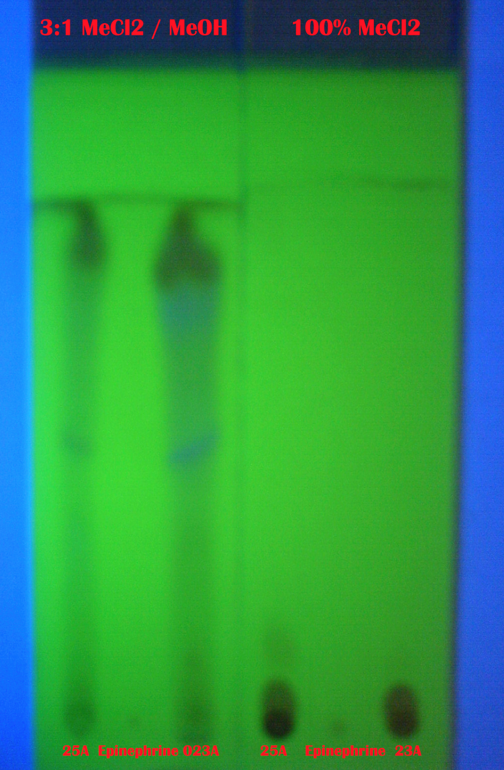
Jean-Claude Bradley 2006

Slide 33
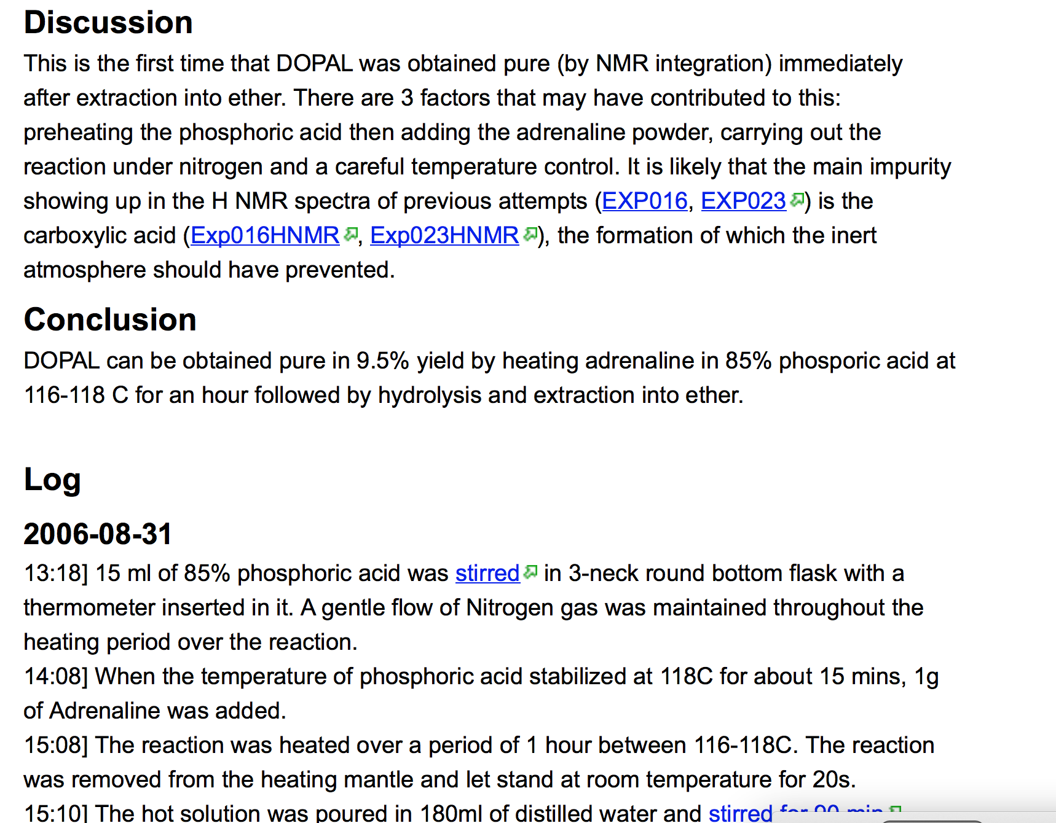
Jean-Claude Bradley 2006

Slide 34
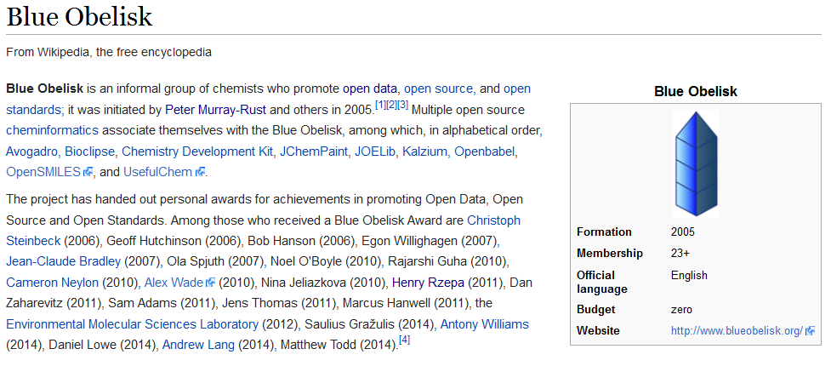
Volunteer community in chemistry: Open Data/Source/Standards

Slide 35
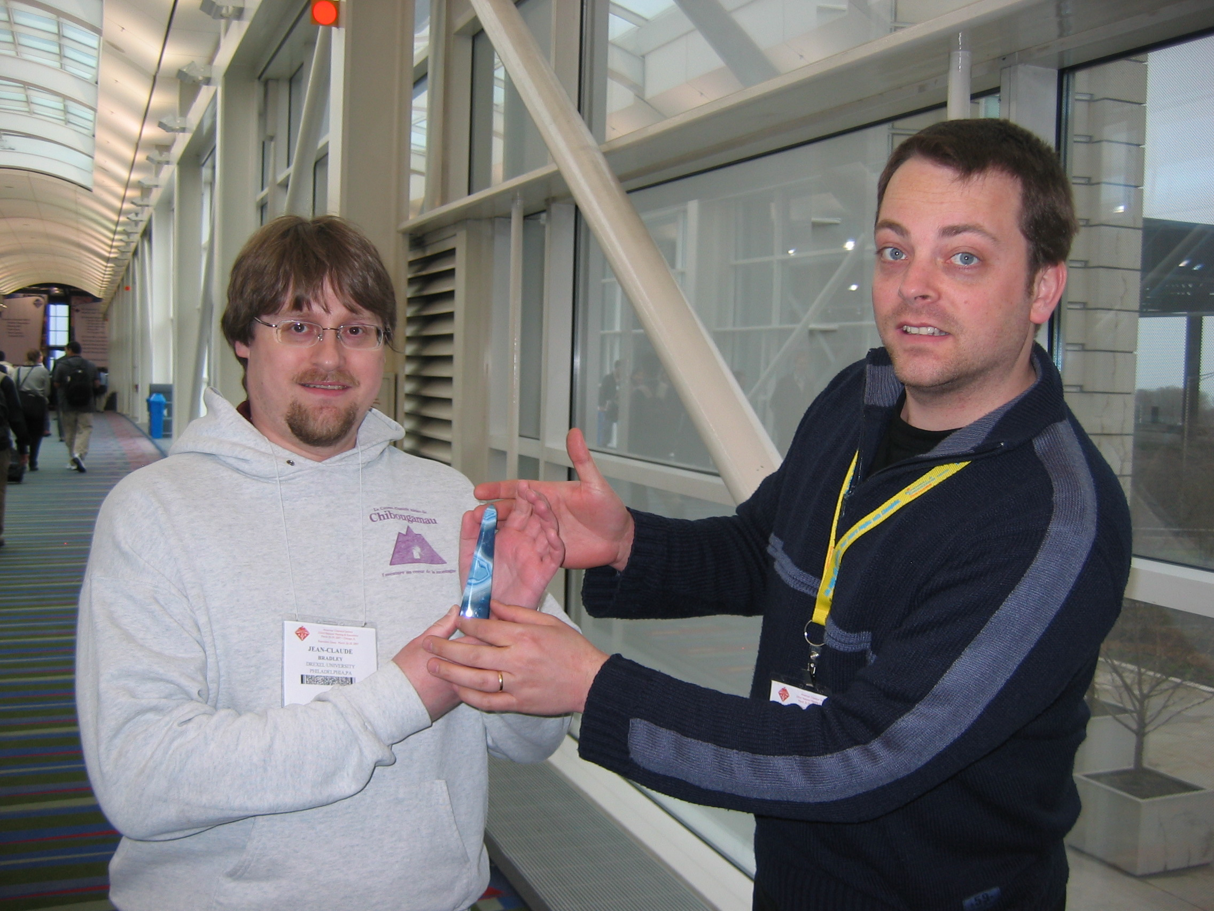
Award of Blue Obelisk
Jean-Claude Bradley
Egon Willighagen

Slide 36
Realising OpenNotebookScience
When a distinguished but elderly scientist states that something is possible, he is almost certainly right. When he states that something is impossible, he is very probably wrong. http://en.wikipedia.org/wiki/Clarke's_three_laws
Open Inspirations (some are zero budget)
Open Street Map
Journal Of Machine Learning Research
Blue Obelisk
arXiV
Protein Data Bank
Galaxy Zoo

Slide 37
Self-benefit drives Open
I put my data/papers in a repository because I HAVE TO
I commit my code to GitHub because I WANT TO:
It’s safe
It’s validated
I know it works
There are tools to search it
Other coders improve and add to it

Slide 38
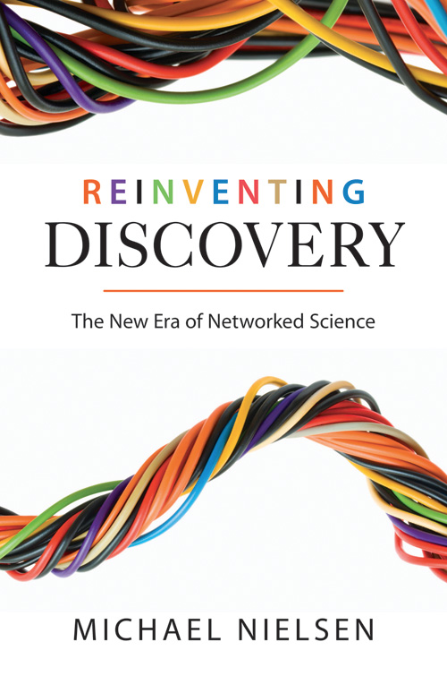

http://en.wikipedia.org/wiki/Reinventing_Discovery
http://michaelnielsen.org/blog/reinventing-discovery/

Slide 39
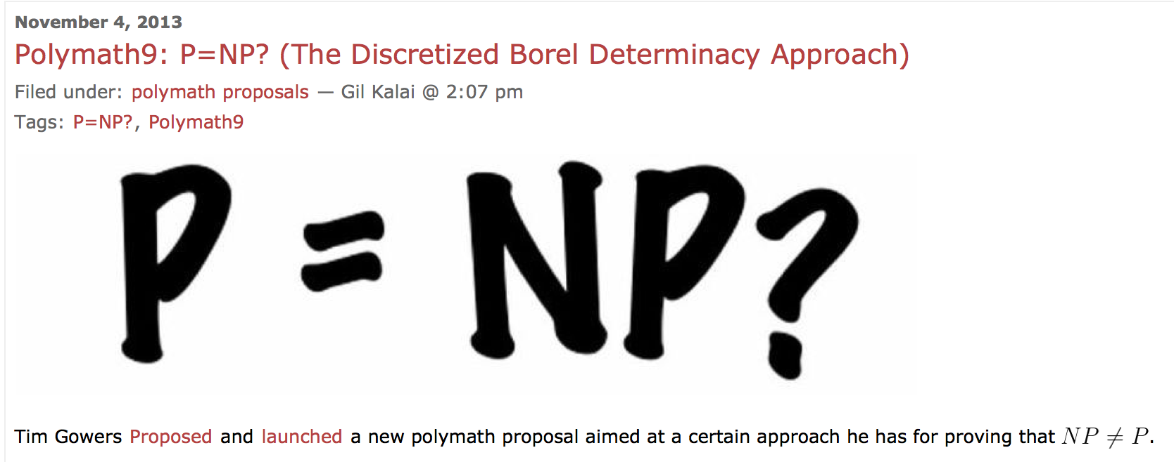
The Polymath project
Tim Gowers and the world
http://polymathprojects.org/2013/11/04/polymath9-pnp/#comments
http://gowers.wordpress.com/2013/11/03/dbd1-initial-post/

Slide 40
Open Notebook Science
TOOLS
Open engineered
repository
validate
DATA
INSTRUMENT
merge
knowledge
DATA
calibrate
MODEL
CODE
Machines and humans
Working together
World
community
Problems are solved communally;
Nothing is needlessly duplicated; “publication“ is continuous ; data are SEMANTIC

Slide 41
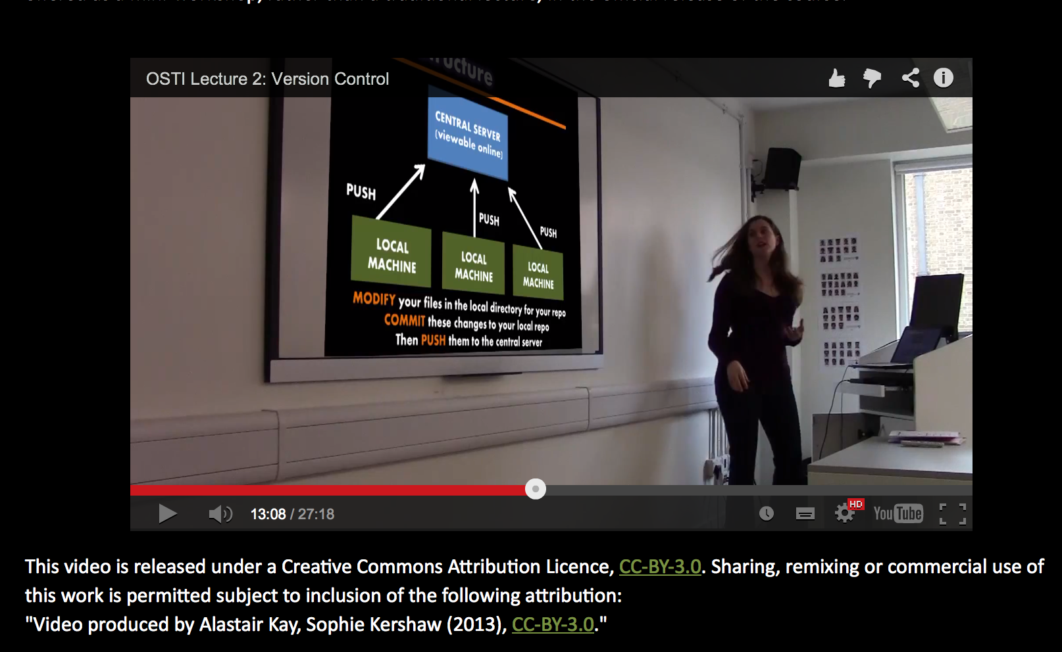
Sophie Kershaw, Panton Fellow

Slide 42
Open Notebook Science
TOOLS
Open engineered
repository
validate
DATA
INSTRUMENT
merge
knowledge
DATA
calibrate
MODEL
CODE
Machines and humans
Working together
World
community
Problems are solved communally;
Nothing is needlessly duplicated; “publication“ is continuous ; data are SEMANTIC

Slide 43
Benefits of OpenNotebookScience
Fraud is virtually impossible
Priority and credit are algorithmically established
It is difficult to be scooped…
Data and ideas cannot be lost
The world discovers you and you the world
Time to announcement is much advanced (?years)
The “publication process” is vastly less onerous
… but others may use your work in other ways

Slide 44
http://www.budapestopenaccessinitiative.org/read
… an unprecedented public good. …
… completely free and unrestricted access to [peer-reviewed literature] by all scientists, scholars, teachers, students, and other curious minds. …
…Removing access barriers to this literature will accelerate research, enrich education, share the learning of the rich with the poor and the poor with the rich, make this literature as useful as it can be, and lay the foundation for uniting humanity in a common intellectual conversation and quest for knowledge.
(Budapest Open Access Initiative, 2003)

Slide 45
Open Notebook Science
TOOLS
ONS
repository
validate
DATA
INSTRUMENT
merge
knowledge
DATA
calibrate
CC-BY
MODEL
CODE
Machines and humans
working together
World
community
Problems are solved communally;
Nothing is needlessly duplicated; “publication“ is continuous and immediate

Slide 46
Traditional Research and Publication
DATA
???
rewrite
“Lab” work
Write
paper/thesis
publish
Validation??
output “belongs”
to publisher
Re-experiment
Is there anything we can do with this?

Slide 47
Open Notebook Science
TOOLS
ONS
repository
validate
DATA
INSTRUMENT
merge
knowledge
DATA
calibrate
CC-BY/0
MODEL
CODE
Machines and humans
working together
World
community
Problems are solved communally;
Nothing is needlessly duplicated; “publication“ is continuous and immediate

